Slide 1
Parent Forum

Slide 2
WE ASKED:
WHAT DOES WELL-BEING MEAN TO YOU?
YOU SAID:
Confidence and self worth, a sense of security and safety in an environment to be heard and respected as an individual whilst supporting and acknowledging others and our differences.
All aspects of a person’s life, physical health, mental health, emotional and spiritual health.
A focus on learning about and practicing having an emotional toolkit. A balance in life between responsibilities and pleasure. Making sure. Ensuring a person has the basic needs highlighted in Maslow’s pyramid- otherwise well-being can not be accomplished.
Mental and physical health, finding a balance
Being comfortable and feeling secure

Slide 3
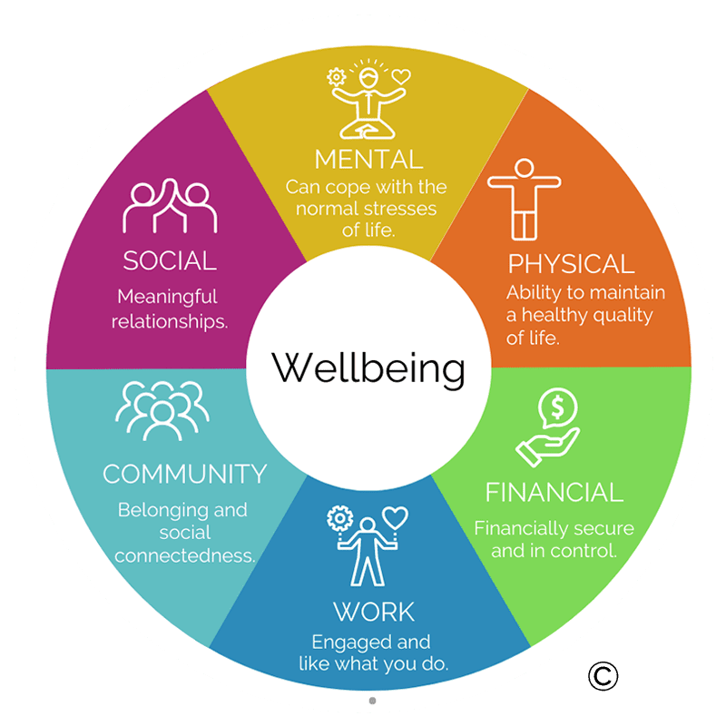
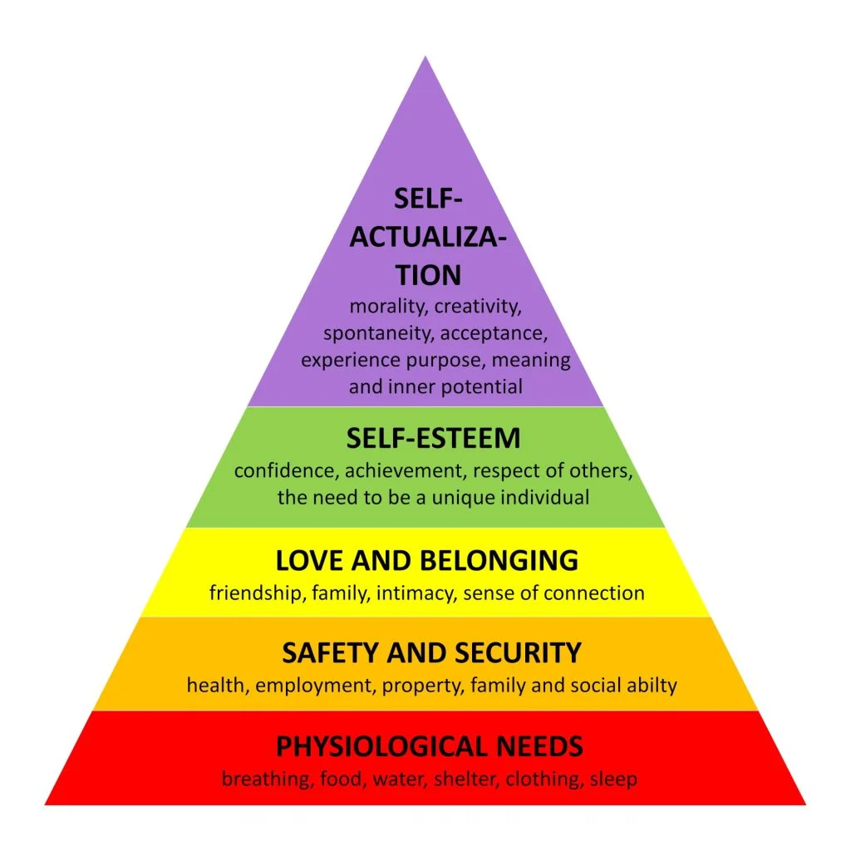

Slide 4
We asked: how is well-being promoted at Waterside?
You said:
Through sharing and learning assemblies, group work and class discussions. Reinforced continually from all staff engaging with the students and through open door policies - with students always having access to someone to talk to when needed.
Provision of sports and physical activities for physical body.
Time spent outside exploring nature, art and design projects for mental, spiritual & emotional health, quiet room to support mental/emotional health when times are tough for an individual.
There seems to be an enriching variety of extracurricular activities, such as the beekeeping, Lego club, the focus on reading and exercise. And having hobbies and past times that are meaningful is what helps strike balance and well-being for a person.
The children know they can talk to the adults or their friends if there are any worries but feel could be promoted more to show all the different ways
Making sure all the children are included

Slide 5
What you might not know:
All teachers and teaching assistants in our school are attachment and trauma aware
Relational support policy
Staff expertise (Thrive, Mental health and well – being curriculum)
ELSA/ TALA programmes
Home school link work
Handy trust
Collaboration with other schools/ agencies
Teaching of learning behaviours like resilience not just curriculum content
Reading Dog – supporting confidence and motivation for groups of children

Slide 6
WE ASKED:
What do you think impacts well-being?
You said:
Home stress/relationships/changes
Absence from school
Basic needs not met, weather and health
Friendships (in/out of school)
Curriculum topics/ teaching methods
Learning difficulties
Challenges in school environment
Distractions in class
Bullying / discrimination
Hostile environments
Too much screen time
Not enough time outside
Lack of sun
Improper diet – lack of nutrients
Lack of positive attention from parents/peers
Medical needs/ appointments

Slide 7
Is there anything you think Waterside could implement to improve the well-being of pupils at Waterside?
You said:
Continue to talk and share knowledge with both staff and students to ensure the topic remains prevalent and available support is known about for easy access.
I think you are all doing a good job.
A drop in ‘safe space’ (peer or adult) during lunchtime or playtime that the children know they can go to if they have a worry or problem, a box or worry box type thing that they could write in a message and an adult could come and talk to them about it at a easier time for all but all know it will be seen and talked about

