Slide 1
Parent Forum

Slide 2
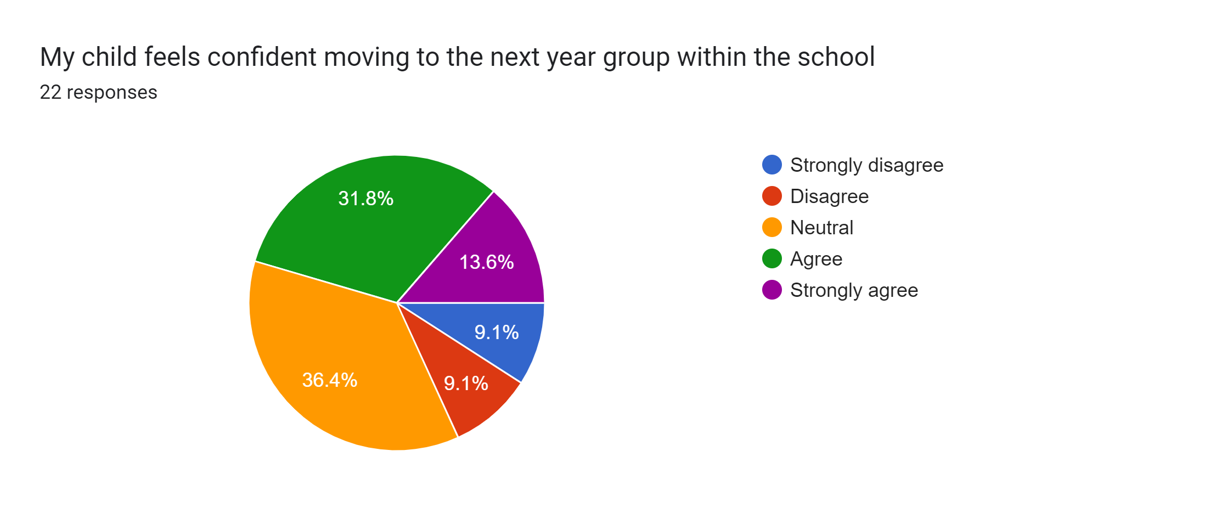
WE ASKED:
My child feels confident moving to the next year group
YOU SAID:

Slide 3
WE ASKED:
Why do you think that is?
Discussions had within the class room area
Not sure he has the understanding of what’s actually happening due to how he processes information
Content in school, familiar with teaching staff and as a whole, the school is well integrated
Being fairly new to the school and forming a secure bond with his current teacher the change will be unsettling for him
He is doing well at school & is comfortable with his peers.
Know the teachers and means that they have achieved all of the years. Always been worried but now learnt don’t need to be worried about changing. Knows what the classroom is like and feels safe
Sufficient communication for parents and introduction sessions for children.
He has a really good relationship with his teachers in year r and I really think he’s going to struggle with the structure in year 1
Change of teacher and class
Because he has only just settled in reception there are lots of things happening at home and he's struggling at the moment I feel he's going to be very upset
Moving class with friends but a new teacher and new goals
Excited and been achieving well thus far
He is so little and didn't like pre school. He may struggle with 5 days a week in a school setting.
Because she always talk about how she likes the school and her teacher's
Great support received from the educators and a good year overall
Because he has seen the next year group and says he goes in there sometimes
She is always asking questions.

Slide 4
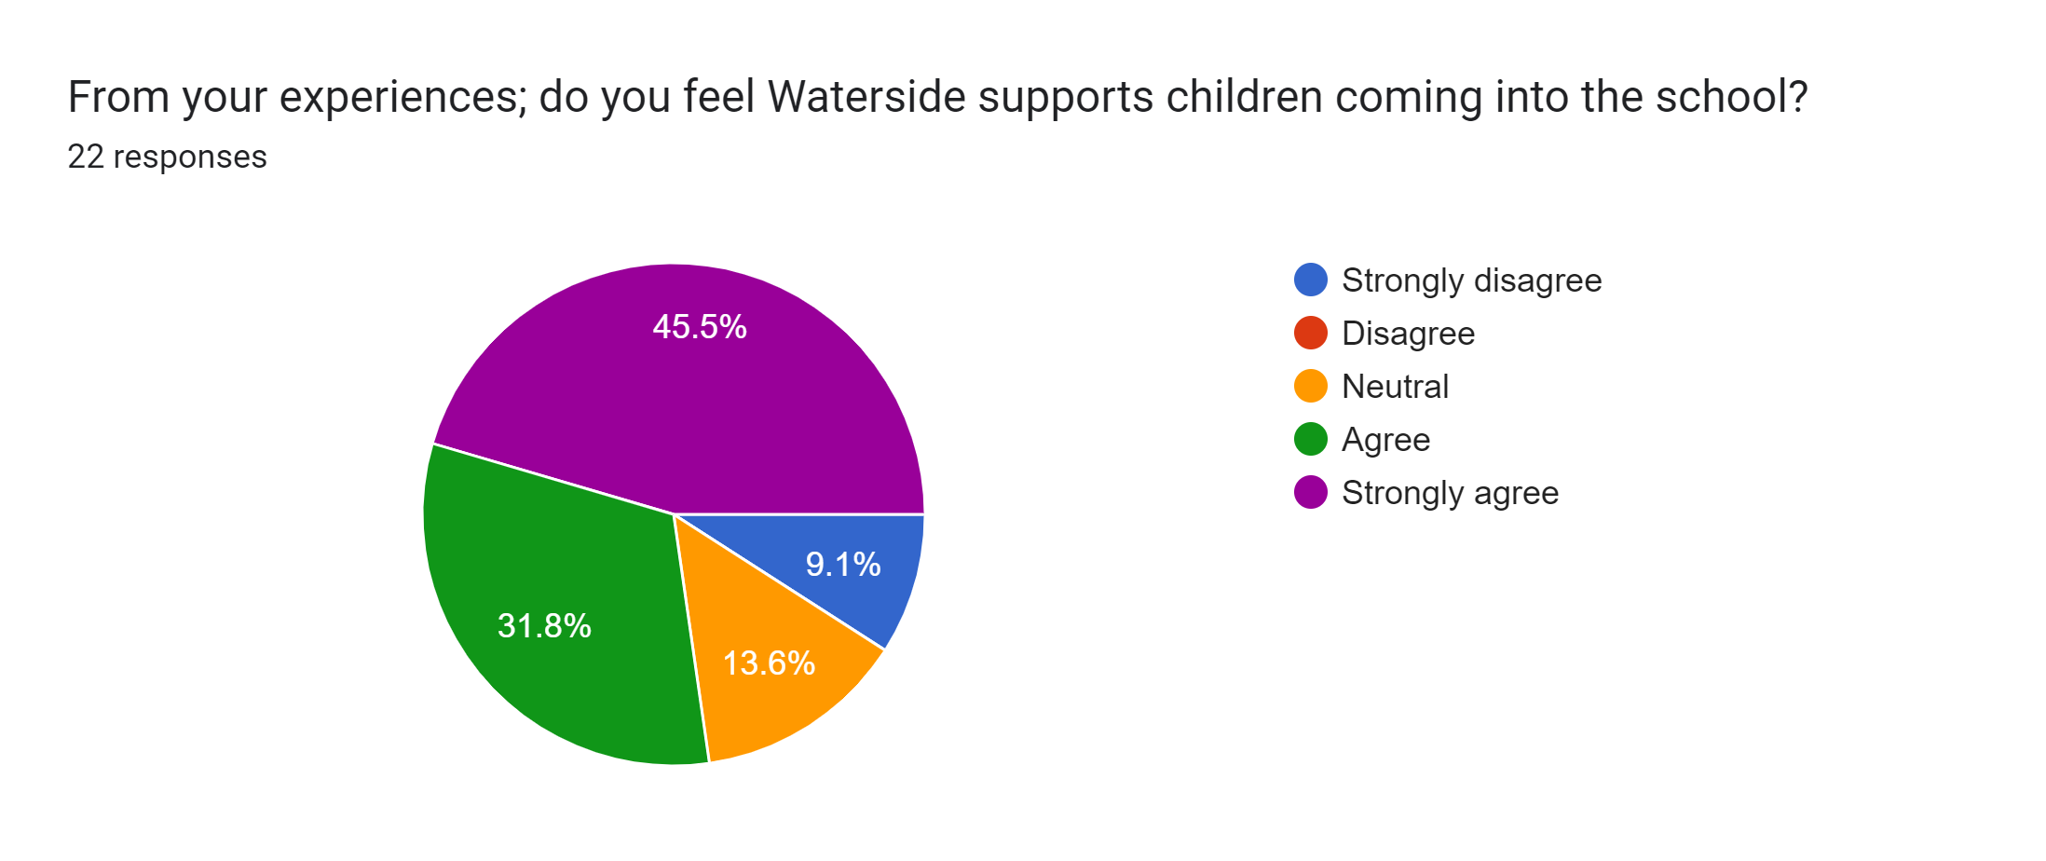
WE ASKED:

Slide 5
We asked: is there ANYTHING ADDITIONAL YOU THINK WOULD SUPPORT NEW PUPILS?
You said:
A buddy system – not just adults
Buddy system or buddy bench
Have a buddy for a month
Settling in sessions
To go to new classroom for a bit to more understanding of next years

Slide 6
What we currently do?
New pupils are welcomed by the whole class and all staff who share responsibility to make pupil feel welcome and a part of what we are doing. Older pupils support younger pupils with play and lunchtime at various intervals
Throughout year classes and pupils collaborate.
All staff make an effort to know all children and come into contact through playtimes and assemblies
Teachers collaborate throughout the year and engage in daily informal discussions around planning, and provision for children – therefore knowing children before they teach them.

Slide 7
Ready to change year groups
Assessment systems are consistent throughout the school, and data is collected forensically around the children’s learning as it happens – which the next teacher is already looking at in planning for September.
Teachers and TA’S will meet with new Teacher and TA in July insets to share information and hand over the class.
Children will have opportunities to write to there new teachers and tell them in their words what they want the new teacher to understand.
Children will visit their new classroom and teachers for at least a morning.
Children with additional needs, or who struggle have already been identified and will be getting to know the teacher and classroom without realising.

Slide 8
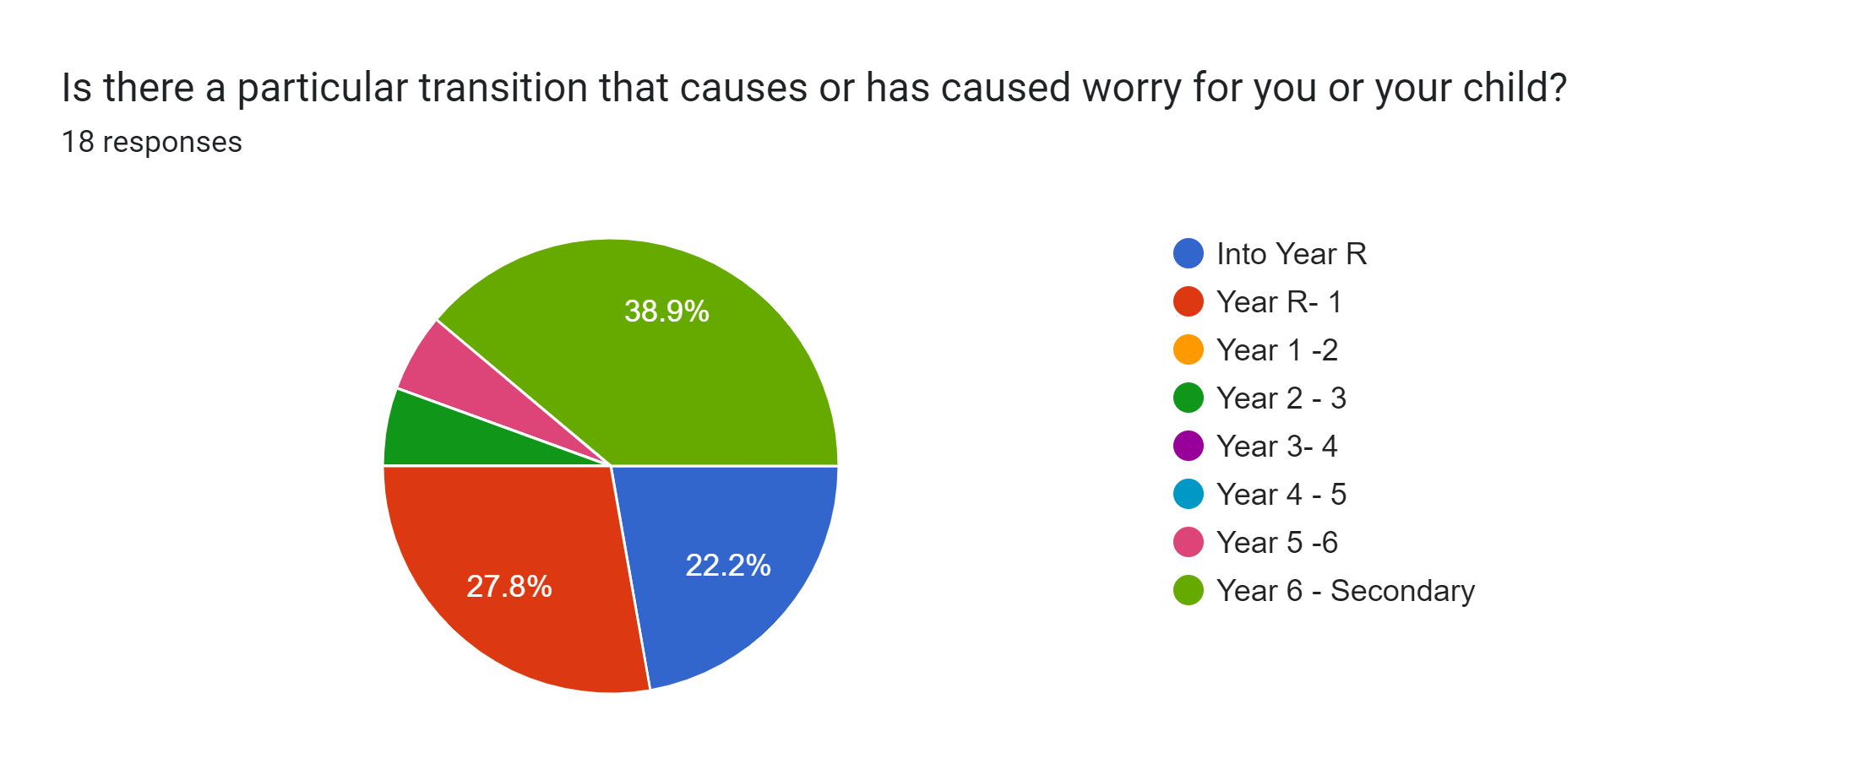
WE ASKED:

Slide 9
New routine
Notable changes to routine, expectations or responsibilities
His behaviour and him struggling with learning and sitting down not having freedom as he don’t do well with sitting for long time
New teachers, higher expectations
Moving schools because it is a complete change.Moving onto secondary after secure primary setting.
The change in our daily routine (not something the school can help with!)
How much bigger the school will be and having to move around the school for different subjects
That they will struggle with the learning set for them
New teacher
The teacher has helped in so many ways I don’t want to have to start again with explaining everything to the new teachers my child’s behaviours, moods etc
My child gets anxiety in new situations/surroundings can cause them to shut down and feel unwell
So far there aren’t any for my kids. They have flourished at Waterside- thank you ☺️
5 day week inappropriate. School. Children he doesn't know
As a first time parent, it would be a good idea to send out a briefing regarding special days, e.g. non-uniform, sports day etc. For new parents, from different backgrounds these might be tricky to figure out and the notifications are not great (facebook posts that we do not see in time or emails sent at a very short notice).
It was mostly me. I was worried about how he would cope but we met with the senco and everything has been perfect
NA

Slide 10
Into Year R
A tea party
Key adults visiting and liaising with pre school settings
Stay and Play sessions
Communications, newsletters and parent mails – prior to starting
Home visits
Mornings and lunch only in first week
Use of tapestry during Year R
Many opportunities to visit/ parent sharing opportunities
Workshops for parents once children have started

Slide 11
Year 6 - Secondary
Children are exposed to and links made with secondary schools all through Year 5/6 (French teaching, subject days, events, performances)
Open evenings provided
On the right track programme
Transitions visits at least 2 days – more provided
Meetings between primary staff and secondary tutors
Shared data
Numerous visits from secondary staff
Conversations in pipeline around transition for parents

